Slide 1
Example of the analysis and design of a bridge according to EC8/2
UNIVERSITY OF LJUBLJANA
Faculty of Civil and Geodetic Engineering
T. Isaković

Slide 2
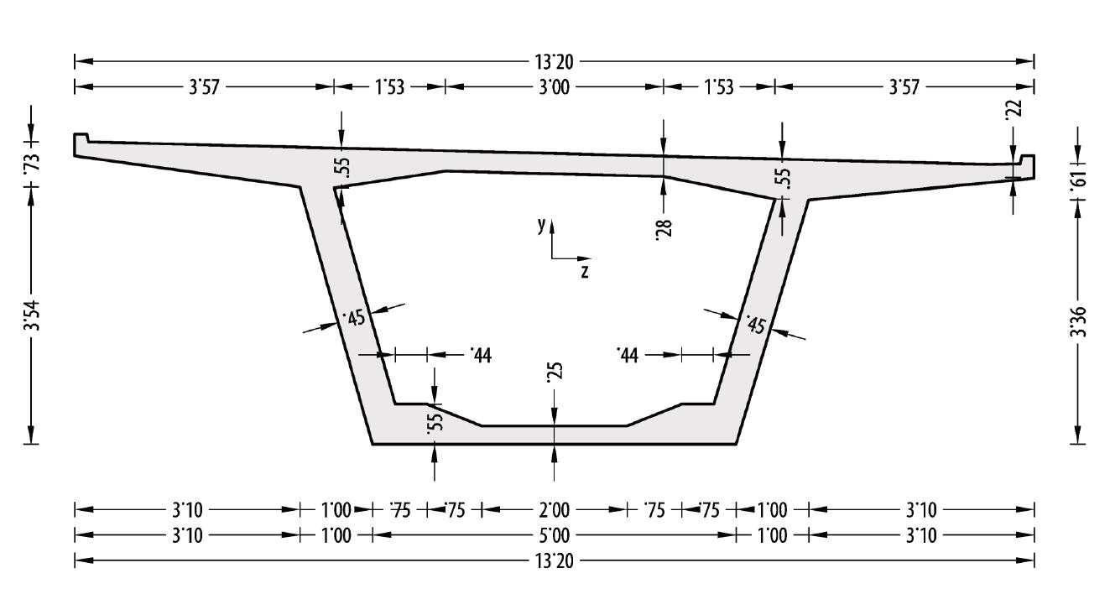
a_{gR} = 0,25g Soil C Bridge II. importance class
Ductile response
S14
S21
S14
14
21
14
30 50 50 30
Deck cross-section
Concrete C35/45 E = 34 GPa
Steel B500
A = 9,65 m² I_{t} = 36,5 m⁴
A_{sy} = 3,82 m² I_{y} = 96 m⁴
A_{sz} =6,93 m² I_{z} = 21,5 m⁴
According to EC8/2 It is reduced to
It = 36,5/2 = 18,25 m⁴

Slide 3
Columns
C 25/30 E = 3,1∙10⁷ kN/m²
A = 3,76 m²
A_{sy} = 1,6 m²
A_{sz} = 2,8 m²
I_{t} = 4,19 m⁴
I_{y} = 5,18 m⁴
I_{z} = 1,94 m⁴
y
40 270 40
h b h
350
z
40 120 40
200

Slide 4
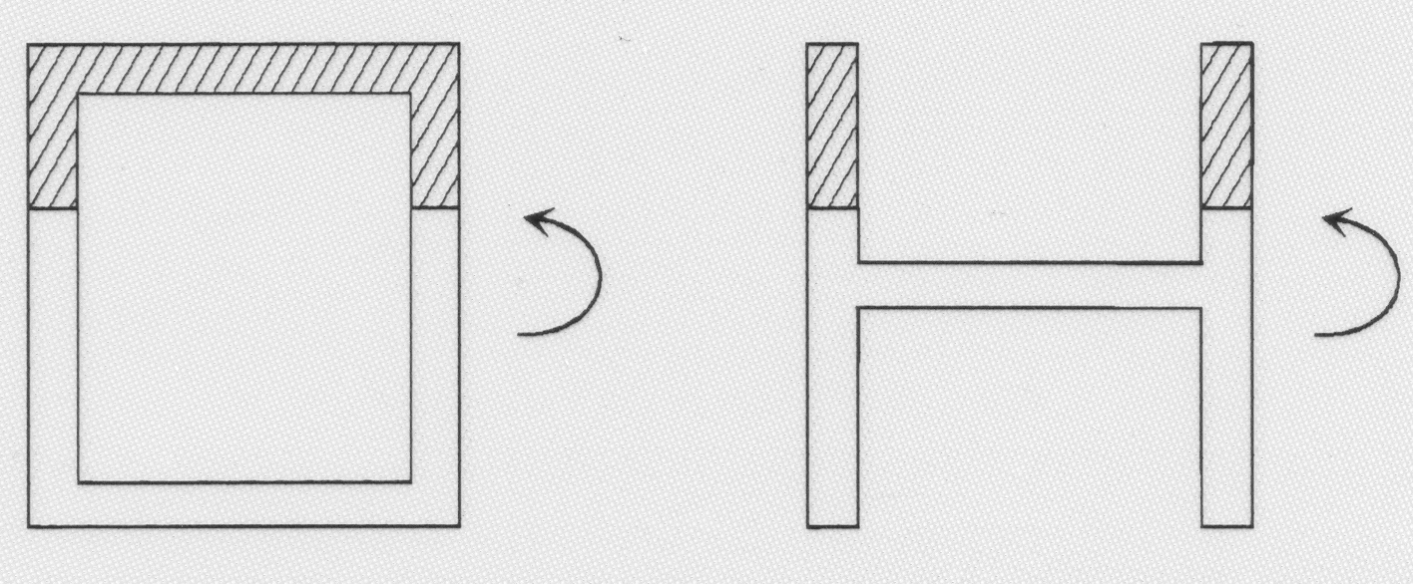
Box cross-section is favourable due to the large width of the compression zone, providing larger ductility
favourable
unfavourable

Slide 5
Analysis
Coordinate systems
S14
S21
y
S14
x
x
z
z
y
Actions
Dead load - superstructure g = 295 kN/m
Weight of piers g_{s} = 94 kN/m
Masses
Bridge of II. importance class – only dead load is taken into account
Mass - deck M_{p} = g / 9,81 = 295 / 9,81 = 30 t/m
Mass - piers M_{s} = g_{s} /9,81 = 94 / 9,81 = 9,6 t/m

Slide 6
Dead load
The axial forces occur in piers
Axial forces at the base of piers (weight of the piers is included)
N_{S14} = 14329 kN
Normalized axial force
N_{S21} = 17485 kN
Normalized axial force
Axial forces in piers are calculated using programme SAP2000

Slide 7
Seismic analysis in the longitudinal direction
Fundamental mode method – Rigid deck model
Field of application:
a) Mass of piers less than 20% of the mass of the deck
M_{s} = (14 +21 +14) 9,6 = 470 t
M_{p} = 30∙160 = 4800 t M_{s} / M_{p} = 0,098
b) Eccentricity – Distance between the centre of mass and centre of stiffness is 0, the bridge is symmetric.

Slide 8
SDOF model of the bridge
Total mass of the structure
M = 30∙160 + (7 + 10,5 + 7) 9,6 = 5035 t
Half of the piers‘ mass is added
Flexibility of piers
Stiffness of piers
Stiffness of the structure
K =2∙k_{s14} + k_{s21} = 144998 kN/m
M
K

Slide 9
Design acceleration spectrum
a_{g} = γ_{I} a_{gR} = 1∙ 0,25 m/s² = 0,25 m/s²
Soil C:
S = 1,15
T_{B} = 0,2 s
T_{C} = 0,6 s
T_{D} = 2,0 s
damping 5%
T_{C} = 0,6 < T = 1,171 s < T_{D} =2 s
q = 1,0
q = 3,5
S_{d} = 1,032 m/s²
T = 1,171 s
Shear span ratio of pier S14 α = 14/3,5 = 4 > 3 => q =3,5

Slide 10
Seismic force in the longitudinal direction
F = M S_{d} = 5035∙1,032 = 5196 kN
Shear forces in piers
Bending moments in piers
M_{s14} = F_{s14} h_{s14} = 2256∙14 = 31584 kNm
M_{s21} = F_{s21} h_{s21} = 685 ∙21 = 14385 kNm

Slide 11
Seismic analysis in the transverse direction
Fundamental mode method – Flexible deck model (FMM)
Structure is subjected to forces F_{i} = M_{i} ∙g
Masses are concentrated in nodes at the equidistant lengths of 5m
Half of the mass of piers is added at relevant nodes
5 x150 t
9 x150 t
9 x150 t
5 x150 t
75t
75t
217,2 t
250,8 t
217,2 t

Slide 12
The scheme of the inertial forces F_{ig} = M_{i}g
5 x 1471,5
9 x 1471,5
9 x 1471,5
5 x1471,5
735,8
735,8
2130,7
2460,3
2130,7
Displacements d_{i}, corresponding to inertial forces F_{ig}
Table 1
node
node
average displacement is 0,135m, maximum difference is 0,0270 m
Ratio 0,027/0,135 = 0,20 – the rigid deck model can be used, however this is the maximum allowed value, therefore the analysis is contnued with flexible model

Slide 13
Using data in Table 1 the following data are obtained:
Period of vibration
Design acceleration
Inertial forces F_{i}
Table 2
node
node

Slide 14
Using programme SAP 2000 the following internal forces in piers are calculated
Bending moments
M_{s14} = 47710 kNm
M_{s21} = 28247 kNm
Shear forces
V_{s14} = 3408 kN
V_{s21} = 1345 kN
In some cases (e.g. in bridges supported by very short coulmns located near the centre of the brdidge) the method can give unrealistic results
Thus an additional control, presented on the next slide, is performed

Slide 15
Displacements d_{i} (Table 1), corresponding to inertial forces F_{ig} = M_{i}g are divided by the ratio S_{d}(T) and g
S_{d}(T)/g = 1,629 / 9,81 = 0,166
Displacements from Table 3 are compared with displacements d_{i1}, corresponding to forces F_{i} (see Table 2)
Table 3 displacements d_{i,0}
node
node
Table 4 displacements d_{i,1}
node
node

Slide 16
Displacements from Table 3 and 4
d_{i,1} (Table 4)
Displacement [cm]
d_{i,0} (Table 3)
Station [m]
Differences between d_{i,0} in d_{i,1}
Differences [cm]
Station [m]

Slide 17
1. Area P_{d}, corresponding to displacements d_{i,1} is calculated
2. Area P_{Δ}, corresponding to differences between d_{i,1} in d_{i,0} is calculated
3. P_{d} and P_{Δ} are compared.
Areas P_{d} and P_{Δ}.are calculated as it is illustrated in the following Figure
If P_{Δ}/P_{d} < 20%, the results of Fundamental mode method are acceptable. Otherwise the response spectrum analysis should be used.
For the analyzed bridge
P_{d} = 3,168 m²
P_{Δ} = 0,161 m²
P_{Δ}/P_{d} = 4,4% < 10% regular structure – FMM can be used.
d_{i,1}^{d}
d_{i,1}^{l}
l

Slide 18
In EC8/2 it is required to take into account the torsional effects when FMM is used.
M_{t} = F e, where F is seismic force, e eccentricity
In the analyzed bridge F = ΣF_{i} = 8149 kN (sum of the forces from Table 2)
e = e₀ + e_{a} = 0 + 0,05 L = 0,05 160 = 8 m
L is the length of the bridge
M_{t} = 8149∙8 = 65192 kNm
This moment is divided to columns supposing the rigid deck, as it is demonstrated in the following slide

Slide 19
100 m
M_{t}
S14
S21
S14
ΔF_{s14}
ΔF_{s14}
ΔF_{S14} = 65192 /100 = 652 kN
Final values of internal forces in S14 are
F_{S14} = 3408 + 652 = 4060 kN
M_{S14} = F_{s14} x H_{s} = 4060 x 14 = 56840 kNm
These forces are not considered in the further design, since the Response spectrum analysis (presented in the following slides) results in smaller demand, because the accidental eccentricity e_{a} should not be taken into account (only in very short and skewed bridges)

Slide 20
Response spectrum method (RSM)
In general the programme is needed to define the fundamental modes of vibration.
Modes of vibrations
mode
2. mode
1. Mode in the longitudinal direction
1. Mode in the transverse direction
T = 1,170 s
T = 0,747 s
m_{eff} = 100 %
m_{eff} = 95 % - translation in the transverse direction
m_{eff} = 71,5% - torsion
T = 0,736 s
3. mode
Torsional mode – rotations around vertical axis
m_{eff} = 24,6 % - torsional mode
Note: Torsional mode is not activated, since the structure is symmetric and the masses are symmetric

Slide 21
In each direction Σm_{eff} should be at least 90% of the total mass
Comparison of the periods of vibrations defined by FMM and RSM
Longitudinal direction
FMM RSM
T = 1,171 s T = 1,170 s
Transverse direction
FMM RSM
T = 0,742 s T = 0,747 s

Slide 22
Spectral accelerations S_{d}(T) corresponding to each mode of vibration are defined
Internal forces and displacements due to the each mode of vibration are defined
Contributions of different modes are combined using SRSS or CQC rule.
Shear forces in piers, defined using FMM and RSM
Longitudinal direction
FMM (without torsion) RSM Difference
V_{s14} = 2256 kN V_{s14} = 2261 kN 0,22 %
V_{s21} = 685 kN V_{s21} = 688 kN 0,44 %
Transverse direction
FMM (without torsion) RSM
V_{s14} = 3408 kN V_{s14} = 3256 kN 4,7%
V_{s21} = 1345 kN V_{s21} = 1408 kN 4,7%

Slide 23
Displacements due to the seismic action
Effective stiffness (cross-section) of RC elements should be taken into account.
Effective moment of inertia I_{eff} can be defined according to Annex C
M_{Rd} – design flexural strength
Φ_{y} – yield curvature
ε_{sy} – yield strain of the reinforcement
ε_{cy} – concrete compressive strain corresponding to yielding of the reinforcement
d_{s} - effective depth of the cross-section
Approximation of curvature Φ_{y} in rectangular cross-sections

Slide 24
ε_{cy}
N
d_{s}
ε_{sy}
To define the effective stiffness the design flexural strength M_{Rd} (flexural reinforcement) should be known.
If the effective stiffness are used only to calculate the displacements, the flexural reinforcement in columns should be defined prior to the estimation of displacements.
If the seismic forces are also estimated based on the effective stiffness, M_{Rd} should be assumed. The assumption should be checked at the end of the analysis.

Slide 25
Bridge
Seismic action in the direction x
F
M
F
M
M
x
x
y1
y1
y
y1
y
F
F
F
x
x
x
F
F
x
M
x
M
x
M
x
y2
y2
y2
=
=
+
Fx
+
Fx
Fy
M
Fy
M
M
M
M
y
M
y
1
1
y
y
1
1
y
y
1
Seismic action in the direction y
1
=
=
+
Fy
+
Fy
Fy
M
Fy
M
M
M
M
F
M
F
y
y
2
2
y
y
2
2
y
y
2
M
2
M
M
y
y
y1
y1
y1
F
F
y
M
y
M
M
y2
y2
y2
F
F
F
y
y
y
Plan view

Slide 26
Bi-axial bending should be taken into account when the flexural reinforcement of piers is defined
100% M_{y}
30% M_{y}
30% M_{x}
100% M_{x}

Slide 27
Estimation of the effective stiffness
The flexural reinforcement in piers is defined first
Results of RSM are considered
Pier S14
The basement of the pier
Transverse direction
N = 14329 kN (axial force due to the dead load)
M_{y} = 45582 kNm
Mz = 9496 kNm (30% of the bending moment in the longitudinal direction)
Longitudinal direction
N = 14329 kN (axial force due to the dead load)
M_{y} = 13675 kNm (30% of the bending moment in the transverse direction)
M_{z} = 31654 kNm

Slide 28
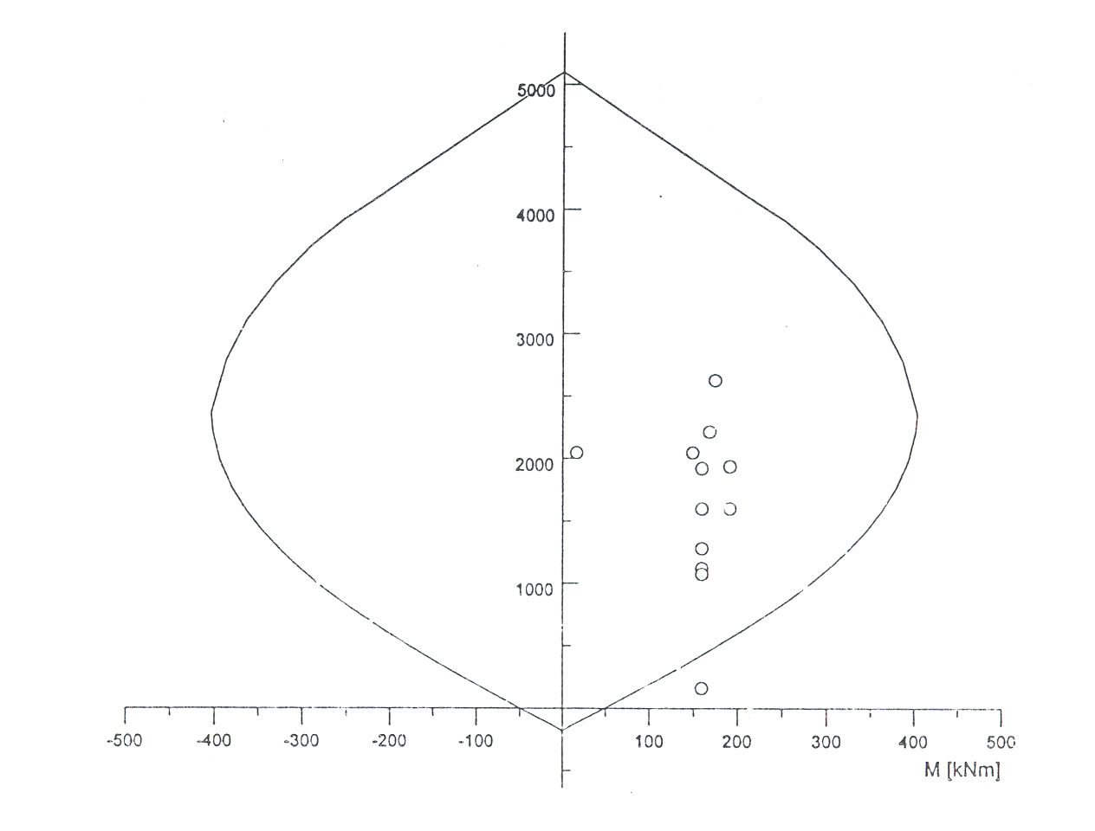
Interaction diagram – uniaxial bending

Slide 29
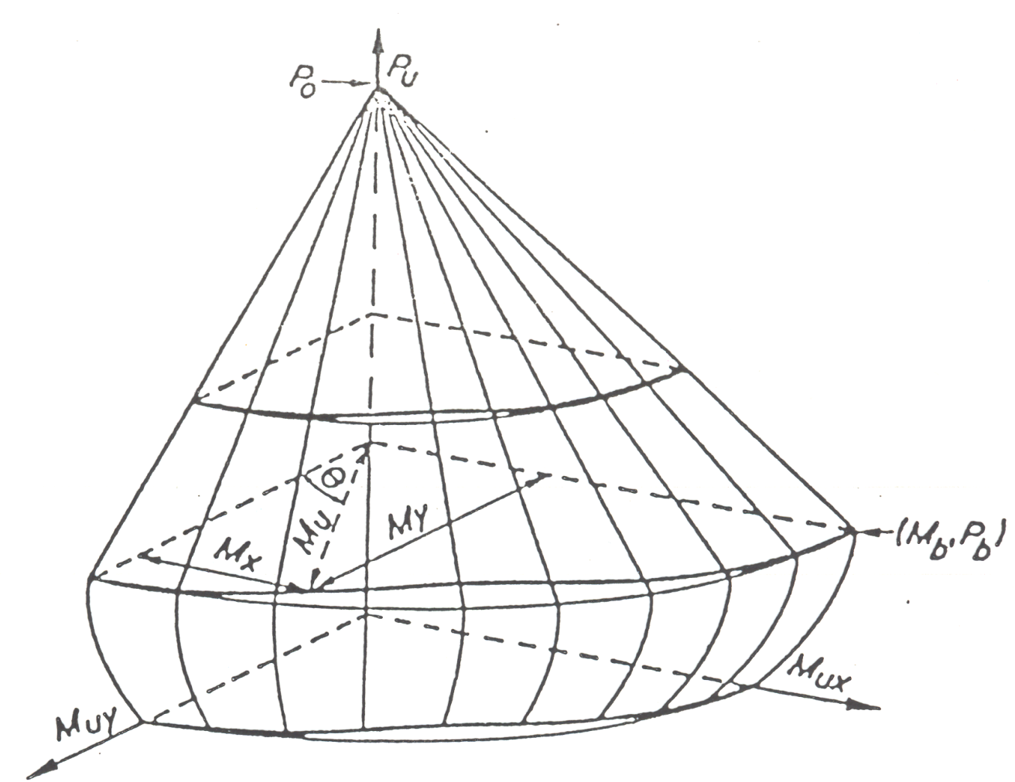
Interaction diagram – bi-axial bending (M_{z}-M_{y}-N)

Slide 30
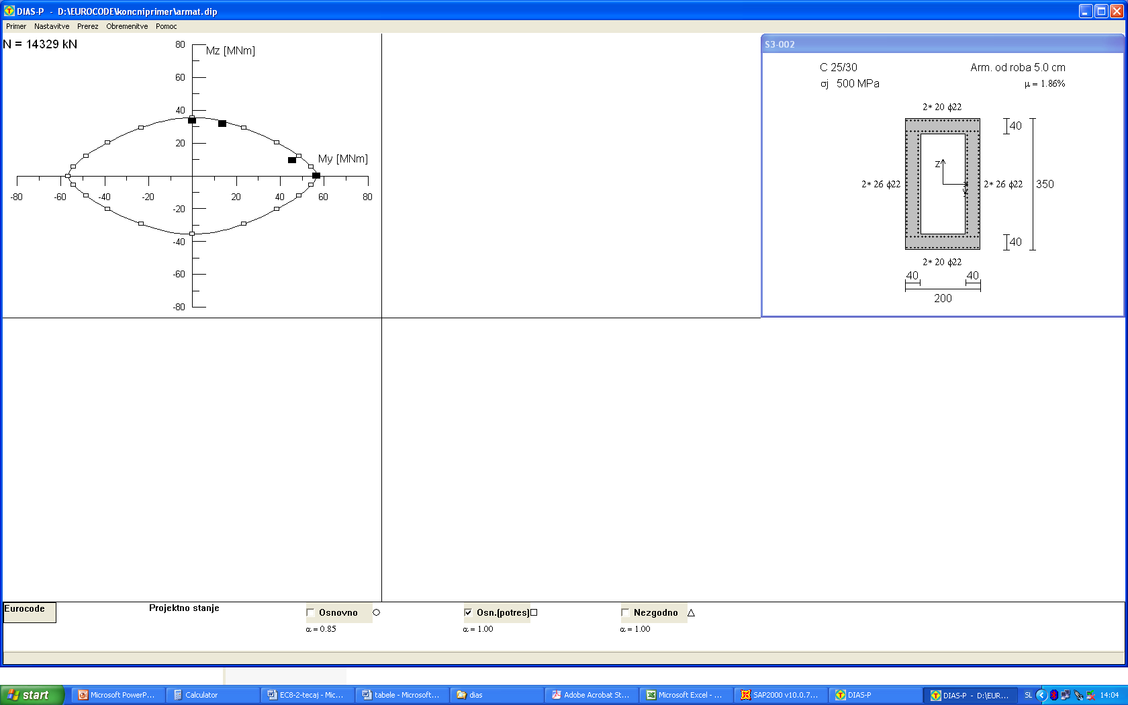
7
7
M_{Rd,z} = 33500 kNm
M_{Rd,y} = 56500 kNm

Slide 31
Effective moment of inertia
Results of RSM are taken into account
Pier S14
Transverse direction Longitudinal direction
Shear areas are also appropriatelly reduced

Slide 32
Pier S21
The basement of the pier
Transverse direction
N = 17485 kN (axial force due to the dead load)
M_{y} = 29567 kNm
Mz = 4332 kNm (30% of the bending moment in the longitudinal direction)
Longitudinal direction
N = 17485 kN (axial force due to the dead load)
M_{y} = 8870 kNm (30% of the bending moment in the transverse direction)
M_{z} = 14440 kNm

Slide 33
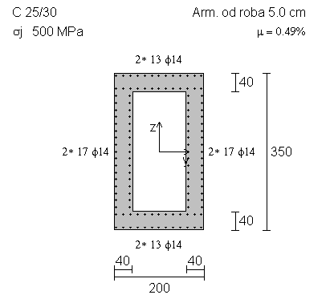

Note:
In EC8/1minimum flexural reinforcement in columns amounts to 1%. The response of hollow box cross-sections is similar to that of the walls. Therefore, the minimum flexural reinforcement of 0,5% was taken into account. This is the minimum reinforcement required in flanges of the walls with limited ductile response - EC8/1
M_{Rd,z} = 20800 kNm
M_{Rd,y} = 34800 kNm

Slide 34
Effective moment of inertia
Results of RSM are taken into account
Pier S21
Transverse direction Longitudinal direction
Shear areas are also appropriatelly reduced

Slide 36
Analysis is repeated taking into account estimated effective stiffness
Periods of vibrations corresponding to the effective stiffness
T₁ = 2,355 s m_{eff} = 100%
T₂ = 1,376 s m_{eff} = 99,6% (m_{eff} = 75% - zasuki okoli z osi)
T₃ = 1,288 s m_{eff} = 25% (zasuki okoli z osi)
Displacements above the abutments:
Displacements corresponding to the reduced seismic action
Longitudinal direction
d_{Ee,long} = 6,12 cm (T1 > 2s displacements are defined based on the elastic spectrum)
Transverse direction
d_{Ee,tran} = 3,80 cm
Displacements due to the seismic action:
Longitudinal direction
Transverse direction

Slide 37
Ragularity of the bridge
r = q M_{Ed} / M_{Rd}
In piers S14 r = q = 3,5, since the flexural strength is fully exploited
Pier S21 can be neglected, since its contribution to total base shear is less than 20%
Longitudinal direction
V_{ES,21} = 688 V_{tot} = 5210 V_{ES,21}/V_{tot} = 688 / 5210 = 0,132
Transverse direction
V_{ES,21} = 1408 V_{tot} = 7920 V_{ES,21}/V_{tot} = 1408 / 7920 = 0,178
r_{max} = r_{min} => ρ = 1 < ρ_{o} = 2 bridge is regular

Slide 38
The presented procedure, used to estimate the seismic action effects in terms of forces is conservtive
They can be also estimated considering the effective stiffness
To estimate the effective stiffness the flexural strength M_{Rd} (flexural reinforcement) should be assumed
According to EC8/1 the effective stiffness can be estimated reducing the stiffness corresponding to the gross cross-sections by 50%. Thus the moments of inertia and shear areas corresponding to gross cross-sections were reduced by 50%.
The corresponding periods of vibrations were
T₁ = 1,654 s m_{eff} = 100%
T₂ = 1,038 s m_{eff} = 99,5% (m_{eff} = 74,9% - torsion)
T₃ = 1,014 s m_{eff} = 24,7% (torsion)

Slide 39
Internal forces in piers
Pier S14
Internal forces at the basement
Transverse direction
N = 14329 kN (axial force due to the dead load)
M_{y} = 34771 kNm
M_{z} = 6713 kNm (30% of the bending moment in the longitudinal direction)
Longitudinal direction
N = 14329 kN (axial force due to the dead load)
M_{y} = 10431 kNm (30% of the bending moment in the transverse direction)
M_{z} = 22377 kNm

Slide 40
Internal forces in piers
Pier S21
Internal forces at the basement
Transverse direction
N = 17485 kN (axial force due to the dead load)
M_{y} = 18494 kNm
M_{z} = 3059 kNm (30% of the bending moment in the longitudinal direction)
Longitudinal direction
N = 17485 kN (axial force due to the dead load)
M_{y} = 5548 kNm (30% of the bending moment in the transverse direction)
M_{z} = 10197 kNm

Slide 41
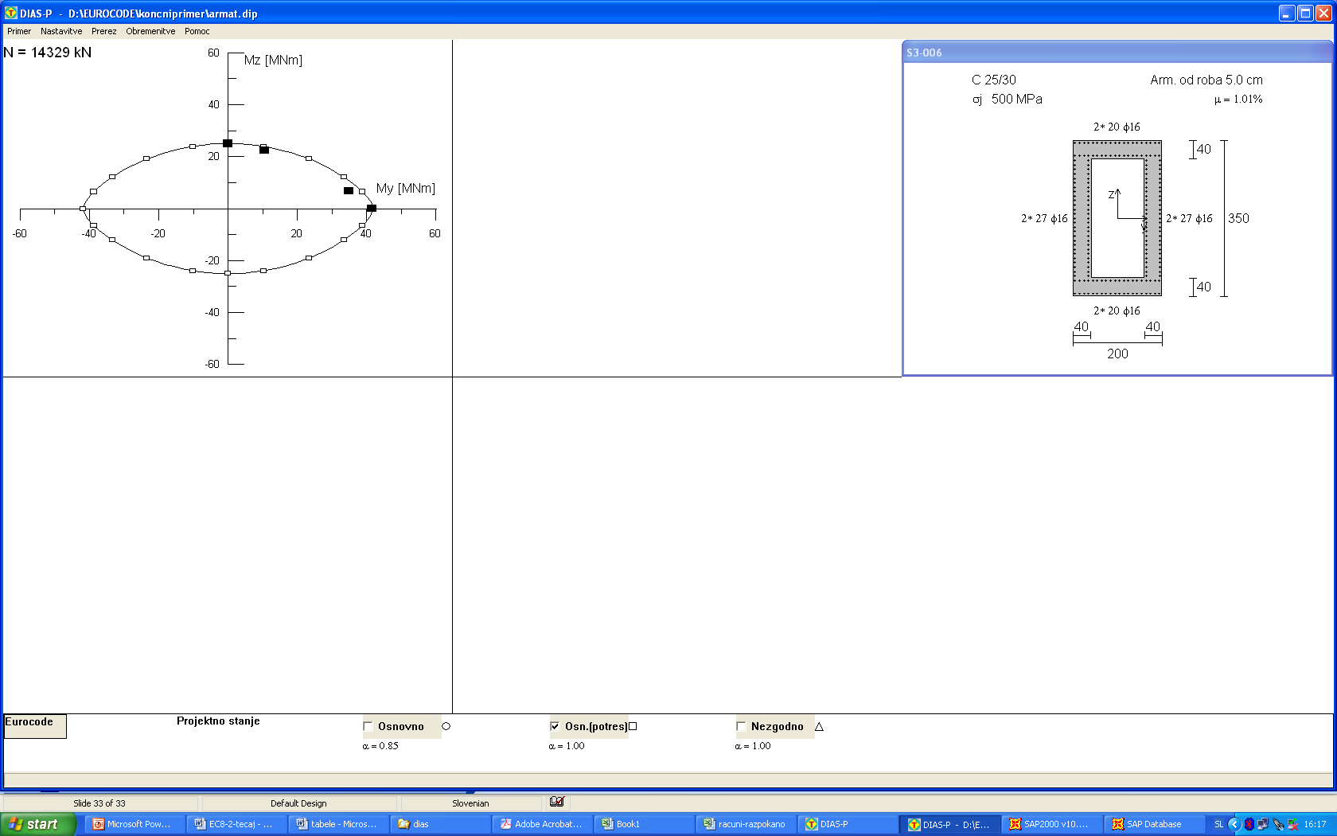
Flexural reinforcement in pier S14
M_{Rd,z} = 25000 kNm
M_{Rd,y} = 41500 kNm

Slide 42
Effective moments of inertia
Pier S14
Transverse direction Longitudinal direction
Shear areas are also appropriatelly reduced

Slide 43
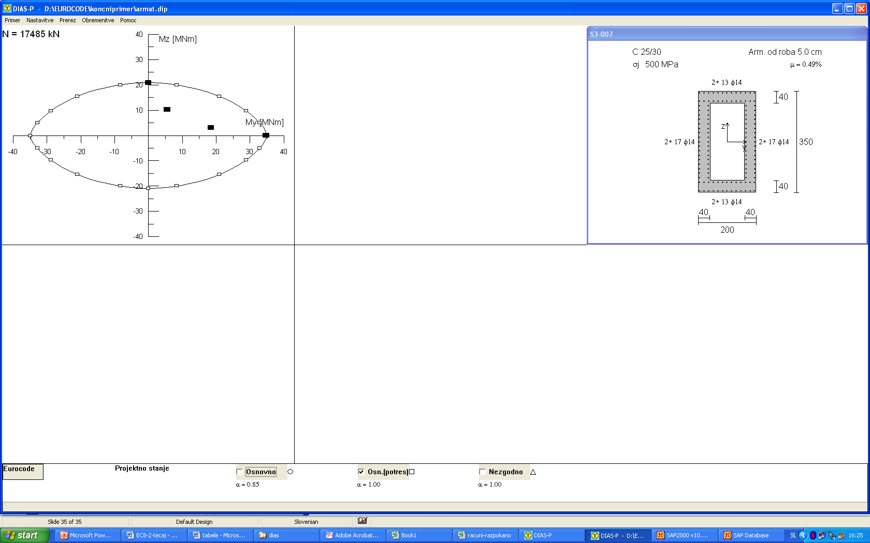
Flexural reinforcement in pier S21
M_{Rd,z} = 20800 kNm
M_{Rd,y} = 34800 kNm

Slide 44
Effective moments of inertia
Pier S21
Transverse direction Longitudinal direction
Shear areas are also appropriatelly reduced

Slide 45
The effective stiffness of pier S14 is smaller than that assumed at the begining of the analysis. Estimated forces are still conservative. Displacements should be estimated based on the reduced effective stiffness.
The effective stiffness of Pier S21 is also smaller than the assumed value.
However it is not clear that the estimated effective stiffness will be actually activated since the provided strength is larger from the required value (minimum reinforcement is provided). Therefore, the reduction of the effective stiffness larger than 50% can not be taken into account for the estimation of forces. For the estimation of displacements the larger reduction of the effective stiffness can be taken into account since the results are conservative.

Slide 46
Displacements (estimated reduction of the effective stiffness was considered)
Periods of vibrations
T1 = 2,642 s
T2 = 1,646 s
T3 = 1,557 s
Displacements above the abutments d_{Ee} due to the reduced seismic action
Longitudinal direction
d_{Ee} = 6,12 cm (elastic spectrum was considered)
Transverse direction
d_{Ee} = 4,82 cm
Diasplacaments due to the seismic action
Longitudinal direction
d_{E} = d_{Ee}∙q = 6,4 ∙3,5 = 21,4 cm
Transverse direction
d_{E} = d_{Ee}∙q = 4,82∙3,5 = 16,9 cm

Slide 47
Comparison of the two approaches
Periods of vibrations
Unreduced effective stiffness (forces) Reduced effective stiffness (50%)
T1 = 1,170 s T1 = 1,654 s
T2 = 0,747 s T2 = 1,038 s
Flexural reinforcement
Unreduced effective stiffness (forces) Reduced effective stiffness (50%) S14 μ = 1,86% S14 μ = 1,01%
S21 μ = 0,50% (minimum) S21 μ = 0,50% (minimum)
Displacements (reduced eff. stiffness) Displacements (reduced eff. stiffness)
d_{e,long} = 21,4 cm d_{e,long} = 21,4 cm
d_{e,tran} = 13,3 cm d_{e,tran} = 16,9 cm

Slide 48
Displacements due to the other actions
Displacements due to the seismic action should be combined with displacements due to the other actions:
a) displacements d_{G} due to the permanent and quasi-permanent actions
(e.g. pre-stressing, creep, shrinkage)
b) Due to the quasi-permanent temperature effects ψ₂d_{T}

Slide 49
Detailing
Flexural strength at the basement
Overstrength factor γ_{o}
Pier S14
Opomba:
Normalized axial force is less than 0,2; Special confinement reinforcement is not required 6.2.4(4)
Therefore, the overstrength factor amounts to 1,35
Pier S21

Slide 50
Flexural strength at the basement
Pier S14
Transverse direction
M_{Rd} = 56500 kNm
M_{o} = γ₀ M_{Rd} = 1,35∙56500 = 76275 kNm
Longitudinal direction
M_{Rd} = 33500 kNm
M_{o} = γ₀ M_{Rd} = 1,35∙33500 = 45225 kNm
Pier S21
Transverse direction
M_{Rd} = 34800 kNm
M_{o} = γ₀ M_{Rd} = 1,35∙34800 = 46980 kNm
Longitudinal direction
M_{Rd} = 20800 kNm
M_{o} = γ₀ M_{Rd} = 1,35∙20800 = 28080 kNm

Slide 51
Plastic hinge length and the flexural reinforcement outside the plastic hinge region
Bending moments that were taken into account to define the flexural reinforcement outside the plastic hinge region
Capacity design bending moments outside the L_{p}
Minimum plastic hinge length:
0,2 H_{s} or depth of the cross-section in the relevant direction (larger value)
In the analyzed bridge the minimum length of the plastic hinge is L_{p} = 3,5m
In pier S14 L_{p} is:
L_{p} = 0,26 ·1400 = 364 cm
In pier S21 L_{p} is:
L_{p} = 0,26 ·2100 = 546 cm
L_{p} = 0,26H_{s}
M_{o} = 1,35·M_{Rd}
M_{Rd}
H_{s} – height of the column

Slide 52
Maximum bending moments outside the plastic hinge region:
Pier S14
Transverse direction
M_{y} = 56500 kNm (N_{G} = 13987 kN)
Longitudinal direction
M_{z} = 33500 kNm (N_{G} = 13987 kN)
Pier S21
Transverse direction
M_{y} = 34800 kNm (N_{G} = 16972 kN)
Longitudinal direction
M_{z} = 20800 kNm (N_{G} = 16972 kN)

Slide 53
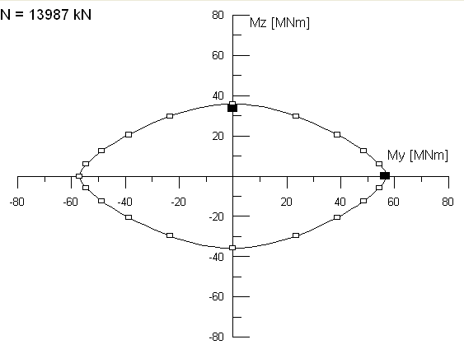
Pier S14
7
7

Slide 54
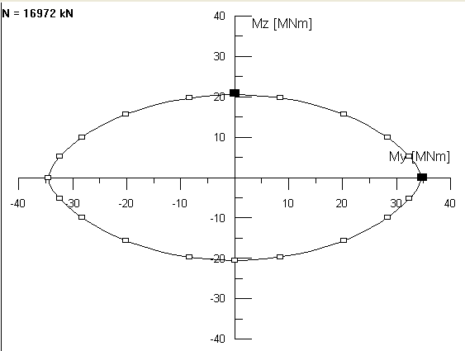
Pier S21
Minimum reinforcement
along the total height of pier S21

Slide 55
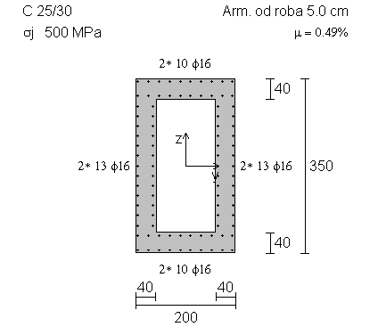
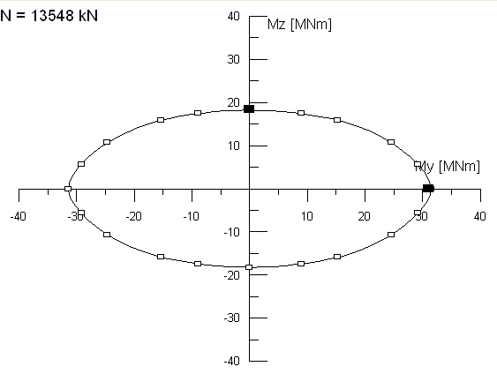
At the top 5,7 m of S14 minimum reinforcement provides adequate flexural strength
N_{G} = 13548 kN
M_{y} = 5,7 / 14 x 76275 = 31050 kNm
M_{z} = 5,7 / 14 x 45225 = 18410 kNm

Slide 56
Shear reinforcement at the plastic hinge region
Calculated based on the maximum shear forces V_{c}
In cantilever columns it is defined as:
Pier S14
Transverse
Longitudinal
Pier S21
Transverse
Longitudinal

Slide 57
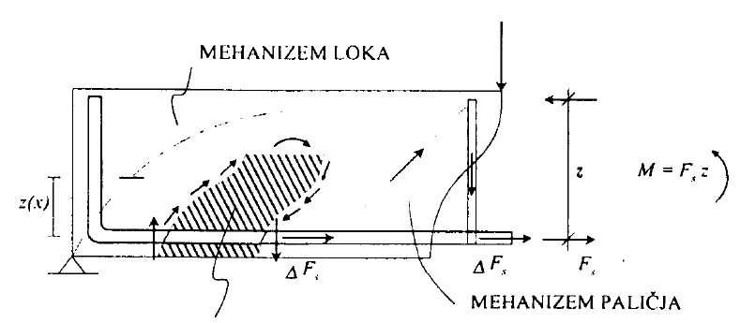
Different shear mechanisms of concrete without shear reinforcement
Arch mechanism
Truss
Concrete shear mechanisms:
friction
dowel
compression zone

Slide 58
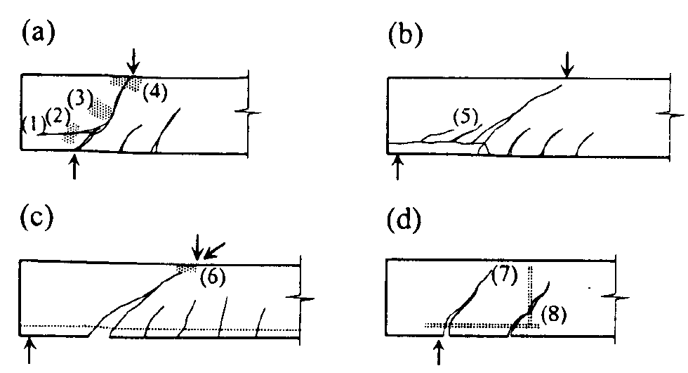
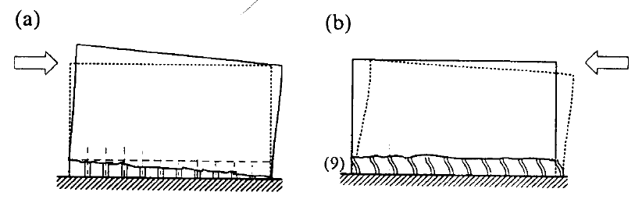
Shear failure modes
Arch failure
Compression diagonal failure
Exceeded principal tension stresses
Failure of the truss mechanism
(e)
(e) Sliding failure –short piers

Slide 59
First the shear strength of the concrete without shear reinforcement is checked
Shear strength of concrete in pier S14
C_{Rd,c} = 0,18/1,5 = 0,12
k₁=0,15
N_{Ed} =14329kN
A_{c} = 3,76
f_{ck} = 25MPa

Slide 60
Transverse direction
V_{Rd,max} = 0,5b_{w}dνf_{cd} = 0,5 0,696 3,103 0,54 16,7 1000 = 9738 kN > 5448 kN
Longitudinal direction

Slide 61
Total shear force should be sustained by the shear reinforcement
Transverse direction
Longitudinal direction
4 legs stirrups φ12/10cm

Slide 62
Shear strength of concrete in pier S21
Transverse direction
Longitudinal direction

Slide 63
Total shear force is sustained by the shear reinforcement
Transverse direction
Longitudinal direction
4 leg stirrups φ8/10cm

Slide 64
Buckling of the longitudinal reinforcement
Two possible failure modes
Large distance between stirrups Small amount of the transverse reinforcement

Slide 65
Maximum distance between stirrups
Pier S14
s_{L} = δ φ
δ = 2,5(ftk / fyk) + 2,25 = 2,5 1,35 + 2,25 = 5,625
s_{L} = 5,625 2,2 = 12,4 cm
ftk – tensile strength of the transverse reinforcement
fyk – yield strength of the transverse reinforcement
Pier S21
s_{L} = δ φ
δ = 2,5(ftk / fyk) + 2,25 = 2,5 1,35 + 2,25 = 5,625
s_{L} = 5,625 1,4 = 7,9 cm

Slide 66
Maximum distance between stirrups legs (the procedure is not correct, will be changed in new version of EC8/2)
Pier S14
s_{l}
s_{l}
Pier S21
s_{l}
s_{l}

Slide 67
Summary of the reinforcement
Pier S14
μ = 0,5%
5,7 m
φ12/10
Shear reinforcement
μ = 1,86%
8,3 m

Slide 68
Summary of the reinforcement
Pier S21
φ8/10
Shear reinforcement
= 0,5%
Minimum reinforcement
φ8/7,5
Buckling
5,46 m

Slide 69
Capacity design:
Superstructure
Bearings
Foundations
Abutments

