Slide 1
DESIGN OF EARTHQUAKE RESISTANT BRIDGES ACCORDING TO EUROCODE 8-2
UNIVERSITY OF LJUBLJANA
Faculty of Civil and Geodetic Engineering
T. Isaković

Slide 2
Observations from past earthquakes
Reinforced concrete piers – insufficient transverse reinforcement
Deficient shear strength
  Inadequate confinement reinforcement
  Buckling of the longitudinal reinforcement
  Longitudinal reinforcement overlapped at the critical regions
Steel piers
Brittle failure
  Buckling of piers

Slide 3
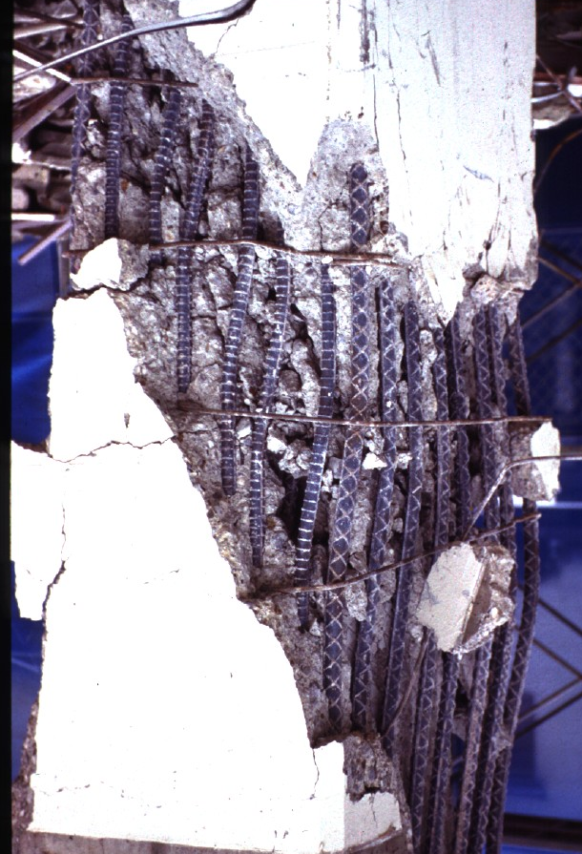
Deficient shear strength

Slide 4
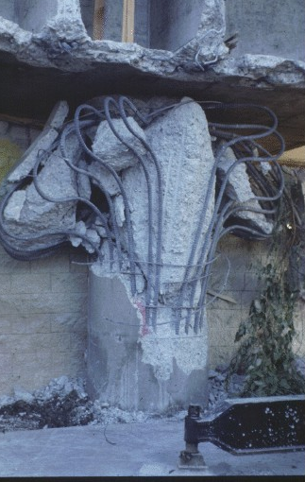
Inadequate confinement reinforcement

Slide 5
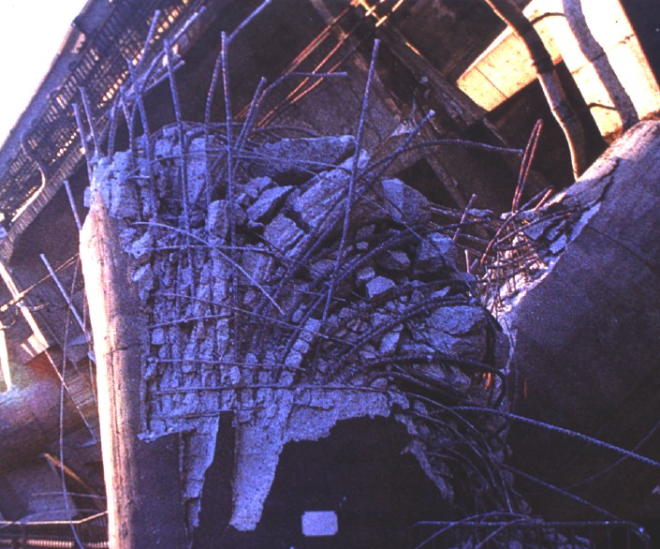
Overlapping of the longitudinal reinforcement in the critical regions

Slide 6
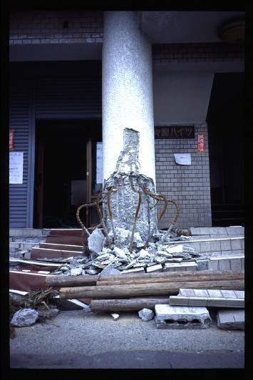
Buckling of the longitudinal reinforcement

Slide 7
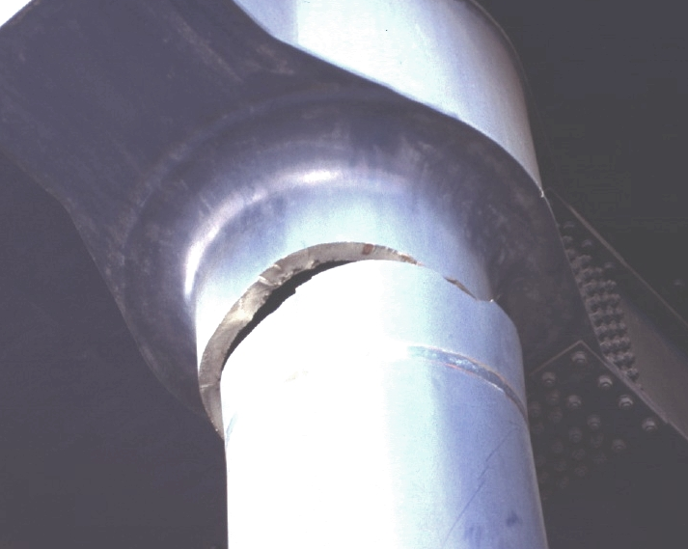
Steel piers – brittle failure

Slide 8
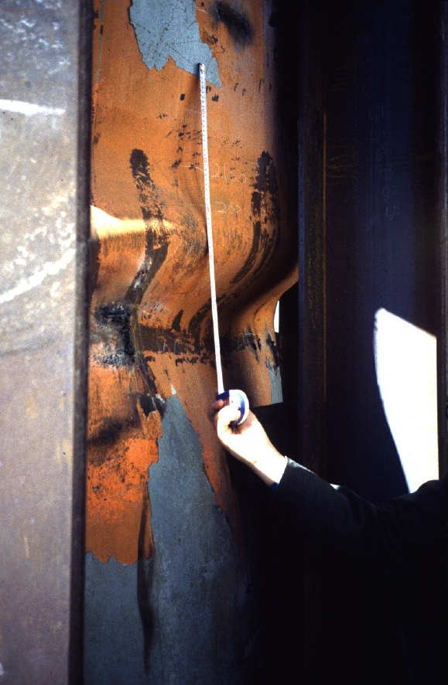
Steel piers - Buckling

Slide 9
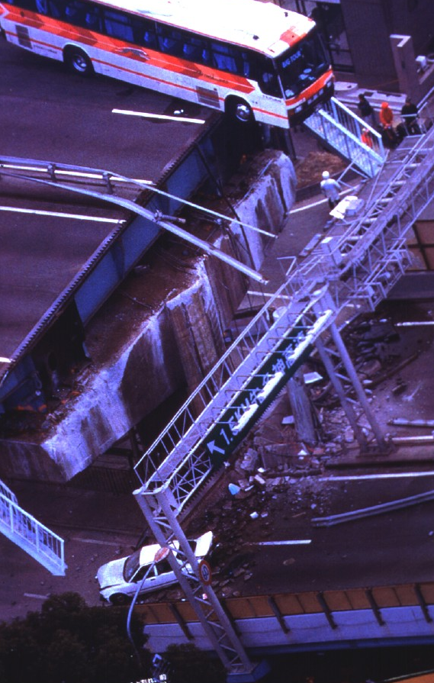
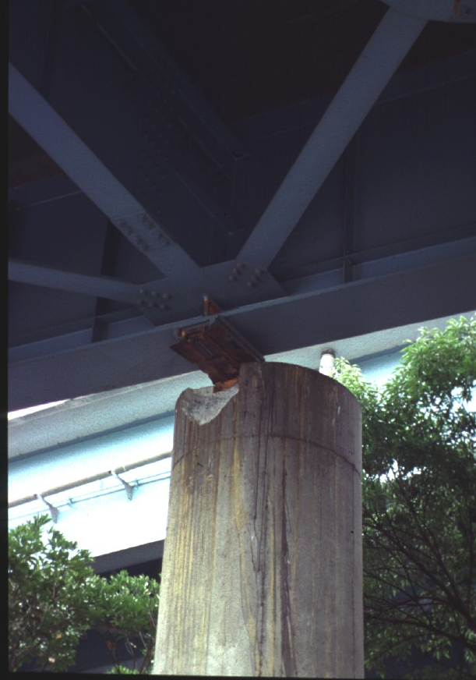
Inadequate seating lengths

Slide 10
Modern standards – better safety

Slide 11
Basic features of EC8/2
I. Explicit reduction of the seismic action
II. Reduction of the seismic action is defined based on the intended type of the response (ductile or limited ductile response)
III. Capacity design
IV. Detailing, which provides the foreseen type of response
V. Control of displacements

Slide 12
I. Explicit reduction of seismic forces
Ideal elastic response
Essentially elastic
response
Limited ductile response
force
Ductile response
displacement

Slide 13
Elastic acceleration spectrum

Slide 14
Type of the soil

Slide 16
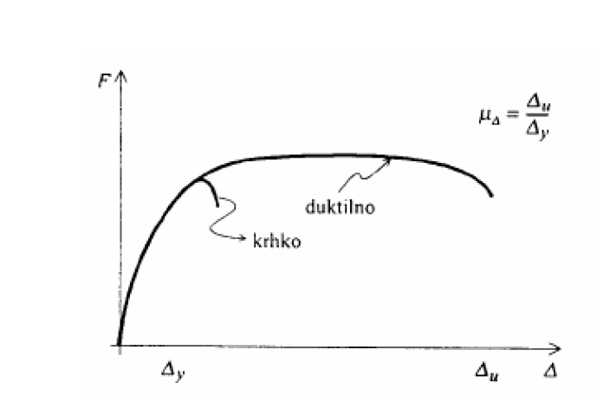
Ductility
Ductility is the ability of the material, the element or the structure to undergo significant inelastic deformations before the failure
Generalized force
ductile
brittle
Generalized deformation

Slide 17
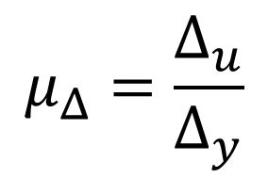
Δ_{u} – ultimate generalized deformation
Δ_{y} – yield generalized deformation

Slide 18
Parameters that influence the ductility of the cross-section
Axial force
Tensile and compression reinforcement
Compression zone
Compression strength of concrete
Amount of transverse reinforcement

Slide 19
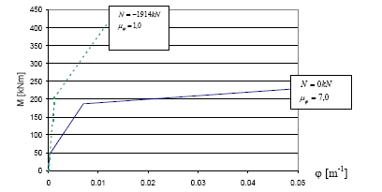
Larger axial forces – lower ductility

Slide 20
Amount and the type of tensile reinforcement

Slide 21
Class of concrete

Slide 22
Confined concrete
unconfined concrete

Slide 23
Behaviour factor q– reduction of the seismic action
Depends on the foreesen type of the response
  Ductile or limited ductile
Depends on the type of elements where the energy is dissipated

Slide 24
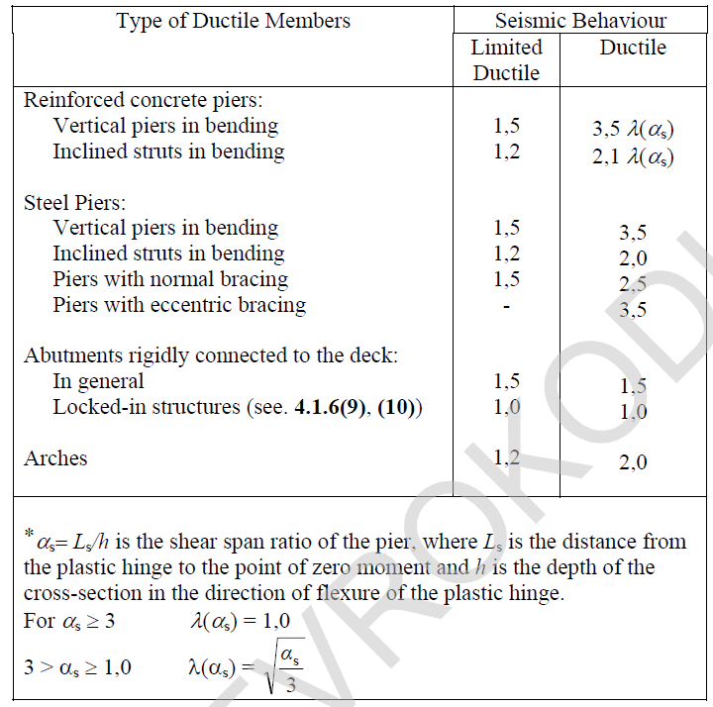
II. Values of behaviour factors - q

Slide 25
II. Maximum values of behaviour factors q
In regular ductile bridges
Regularity should be explicitely checked

Slide 26
II. Regularity
Local reduction factor
ρ₀ = 2

Slide 27
II. Large compression stresses
η
> 0,6
k
q_{r} = 1

Slide 28
II. Short columns – lower ductility
α_{s} = L/h
L
h
q_{r} = q α_{s}

Slide 29
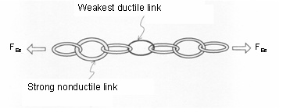
III. Capacity design
Brittle types of failure should be prevented

Slide 30

III. Capacity design - column
V
= M
/h
C,O
O
M_{C}
h
L_{h}
M_{Rd}
M
=
γ
M
O
O
Rd
L_{h} – plastic hinge region

Slide 31
Shear strength
Shear failure
B
C
Shear force
A
d
Top displacement d
p

Slide 32
III. Shear strength – plastic hinge region
According to EC2; strength V_{Rd,c}, V_{Rd,s} in V_{Rd,max} is reduced by factor
If max V_{C} is larger than V_{Rd,c} shear force should be sustained by shear reinforcement
Alternative 1
Alternative 2

Slide 33
III. Capacity design - structure
V
= M
/h
V_{C,0} – maximum possible shear force in column:
calculated based on the flexural capacity of the column (taking into account an ovrestrength)
C,O
O
action on bearing
h
actions on fundation
M
=
γ
M
O
O
Rd
V
= M
/h
C,O
O

Slide 34
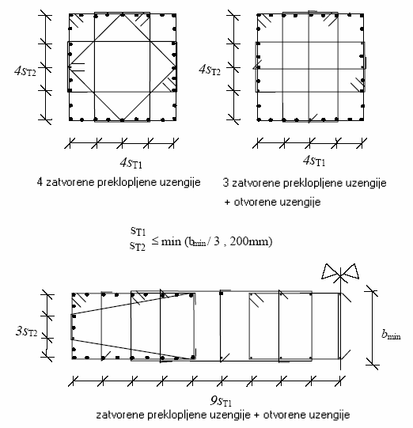
IV. Confinement reinforcement - details
Typical confinement details

Slide 35
IV. Confinement reinforcement – plastic hinge region
Mechanical reinforcement ratio
Rectangular cross-sections Circular cross-sections
Dimensions of the concrete core – between stirrups

Slide 36
IV. Required confinement reinforcement
Rectangular cross-sections
In each direction
Circular cross-sections

Slide 37
IV. Minimum confinement reinforcement

Slide 38
IV. Transverse reinforcement that secure column against buckling of compression longitudinal reinforcement
s_{L}
Maximum distance in longitudinal direction of column – s_{L} = 5-6 φ_{long.}
s_{L}

Slide 39
V. Displacements due to the seismic action
Reduced seismic action: displacements d_{Ee}
Actual displacements
Long periods of vibration T > 1.25 T_{C}
Short periods of vibration

Slide 40
V. Estimation of displacements
Iterative – effective cross-section
Based on the assumed design strength M_{Rd}
This assumption should be checked after the analysis
If required M_{Rd,req} is less than the assumed value, displacements are multiplied by M_{Rd}/M_{Rd,req.}
If M_{Rd,req} is larger, the analysis should be repeated, seismic demand is larger

Slide 41
Annex C – Method 2
1
M
–
Design flexural strength
,
=
2
M
Rd
E
I
Rd
Φ
c
eff
Φ
y
–
Yield curvature
(
y
)
ε
−
ε
ε
–
Yield strain of the reinforcement
Φ
=
sy
cy
sy
y
d
ε
–
Compressive strain of concrete
s
cy
d
-
Effective depth of the cross-section
s
Φ
can be estimated as (rectangular cross-sections)
ε_{cy}
y
Φ
=
2
ε
,
1
/
d
y
sy
s
N
d_{S}
ε_{sy}

Slide 42
Methods of analysis
Elastic methods of analysis
  Response spectrum method: reference method (RSM)
  Fundamental mode method (FMM)
Nonlinear methods of analysis
- Simplified pushover based analysis – N2 method
- Dynamic nonlinear response history analysis (NRHA)
Nonlinear methods of analysis cannot be used to relax the results of elastic methods of analysis

Slide 43
Appendix:
Bridge Design Example according to EC8-2

Slide 44
EC8/2 versus former design practice
Bridge
Flexural reinforcement
Transverse reinforcement
EC8
As built
EC8
As built
* bridge was designed taking into account modern sesimic design philosophy

Slide 45
Existing bridges with substandard details
Eurocode 8-2 regulates mainly the design of new bridges
Eurocode 8-3 regulates the seismic assessment and strengthening of existing buildings

Slide 46
EC8 – 3: Methods of analysis
Elastic analysis considering the reduced design acceleration spectrum (q = 1,5)
Elastic analysis considering the elastic (unreduced) acceleration spectrum
Non-linear analysis (static or dynamic)

Slide 47
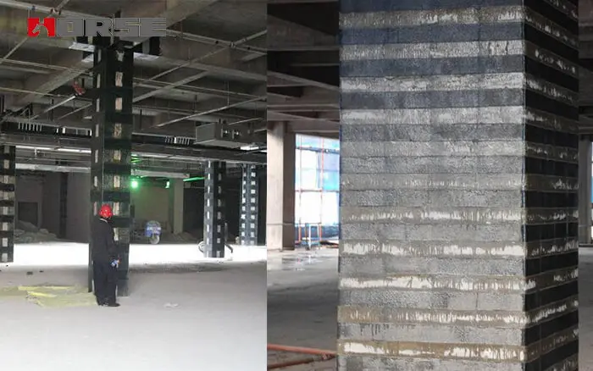
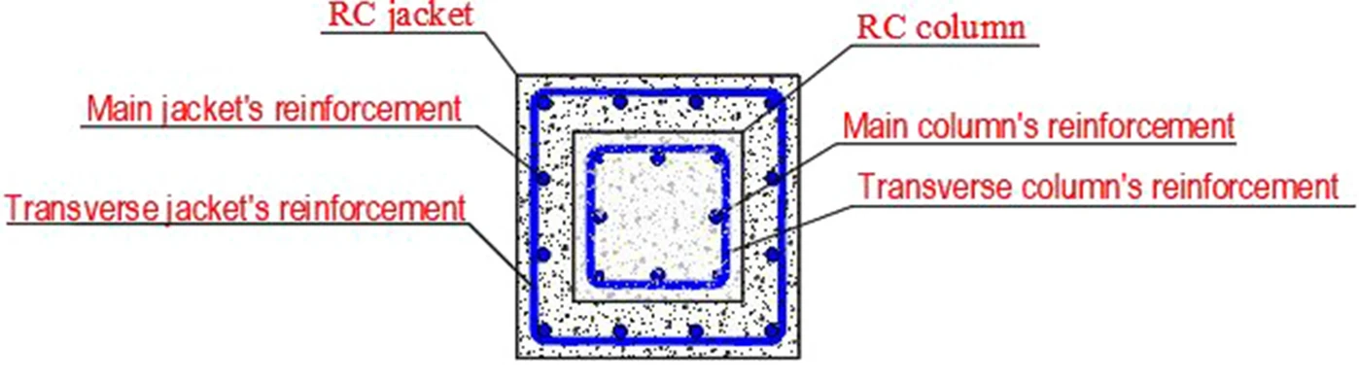
Strengthening
Depends on the type of deficiencies
Increasing resistance
  Strengthening of columns using concrete, steel or FRP jacketing

Slide 48
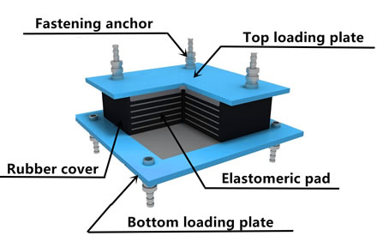
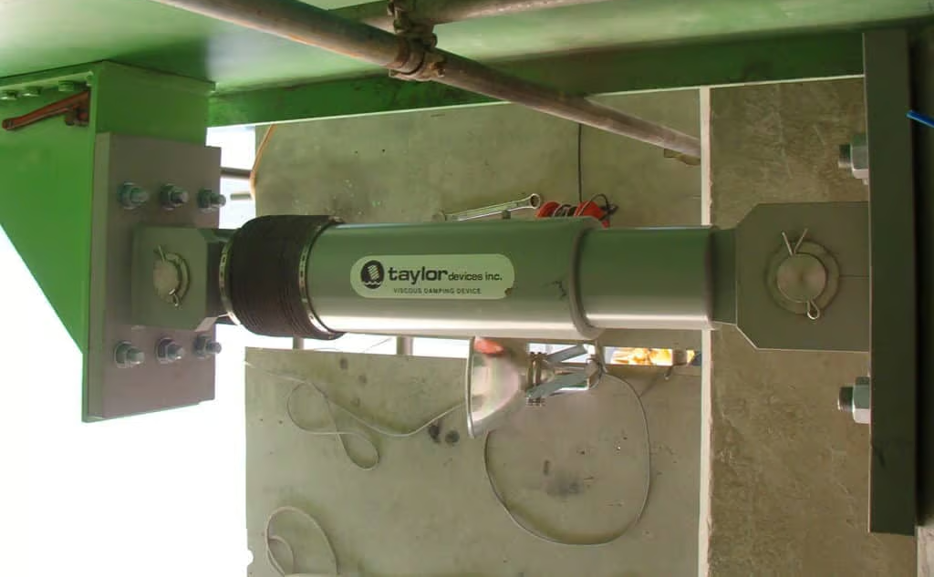
Strengthening
Reducing demand
  Base isolation and the increase of damping – high-damping rubber bearings (damping 15 % - 20%), dampers

Slide 49
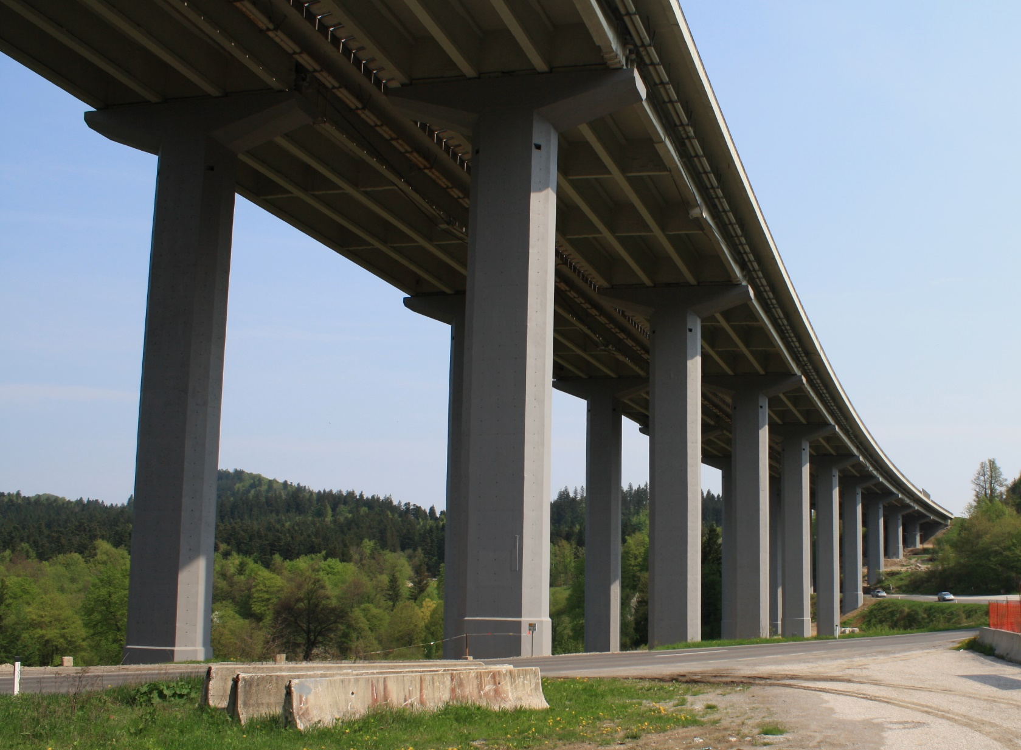
An example of the increased strength

Slide 50
Experiments (Scale 1:4)
Assessment of as-built columns

Slide 51
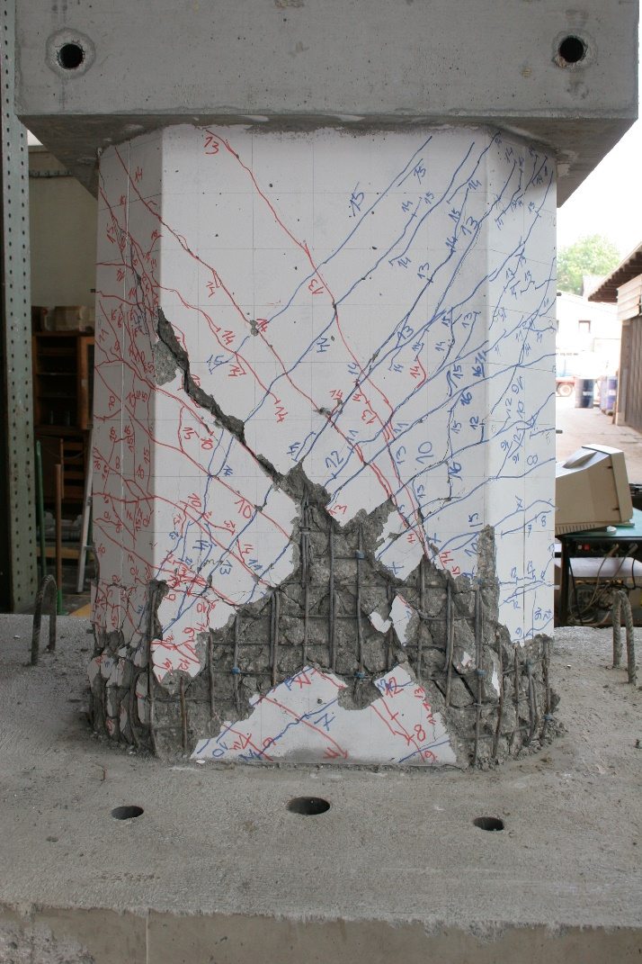
Response of as-built short column

Slide 52
The increase of resistance – concrete jacketing

Slide 53
Response of as-built and strengthened short column

Slide 54
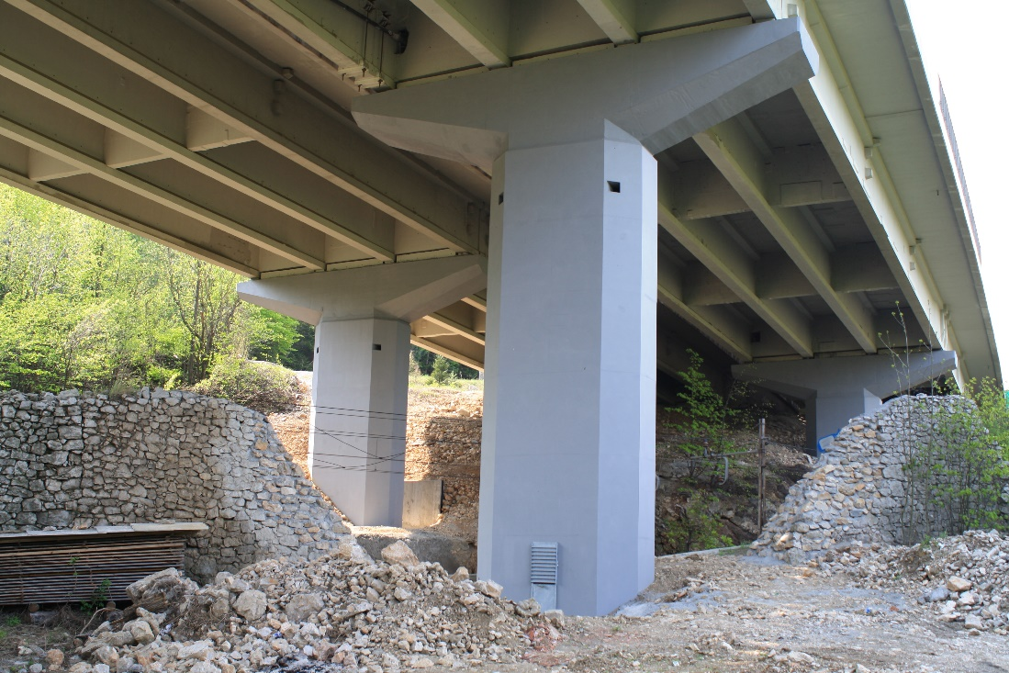
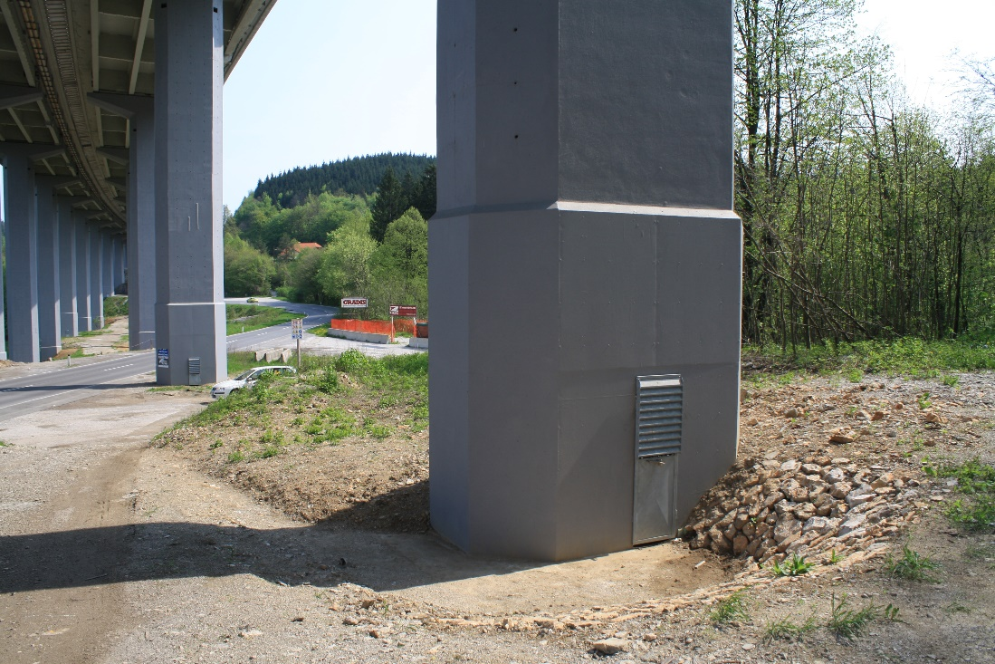

Slide 55
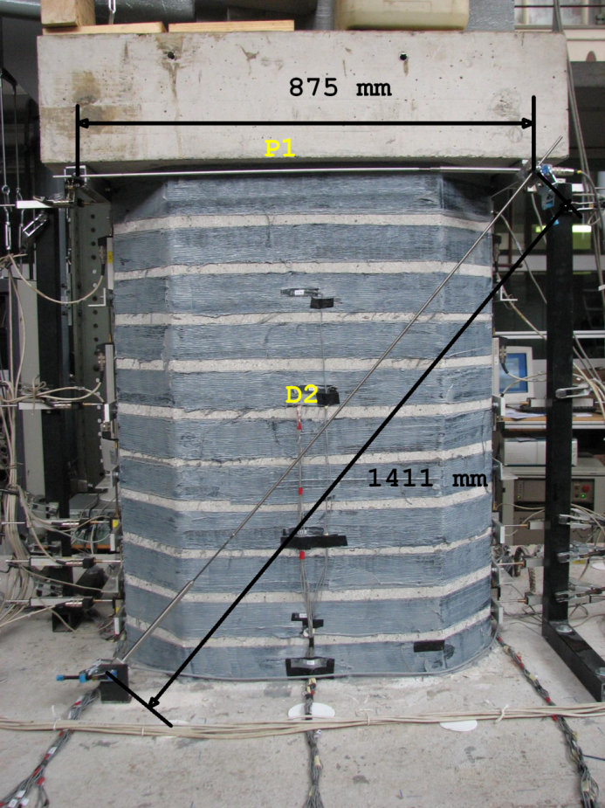
The increase of resistance –
FRP jacketing

Slide 56
Response of as-built and strengthened short column
FRP
Concrete

Slide 57
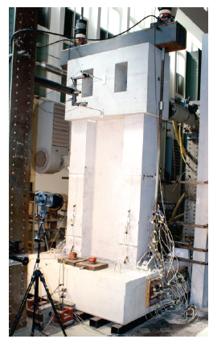
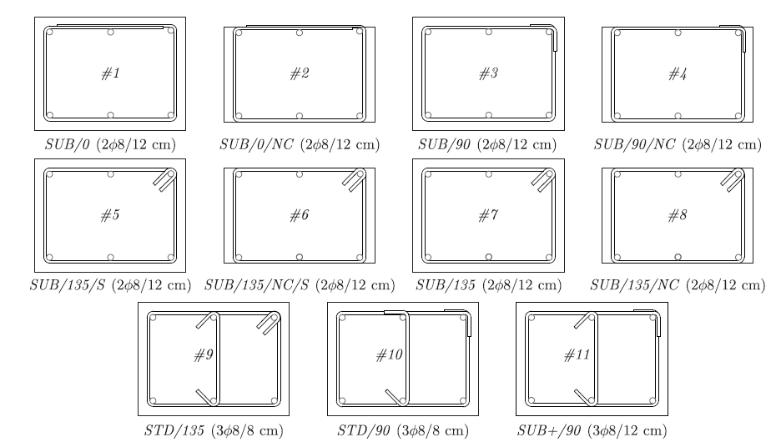
FRP jacketing

Slide 58
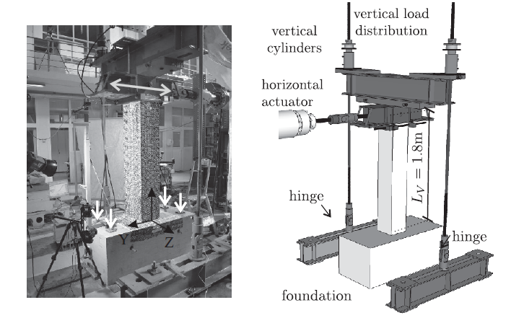
FRP jacketing

Slide 59
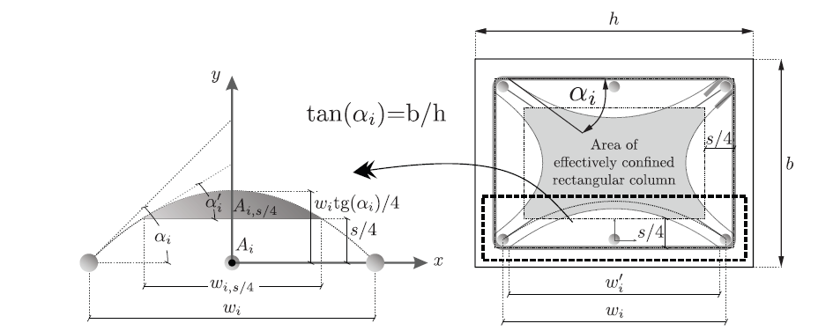
FRP jacketing

Slide 60
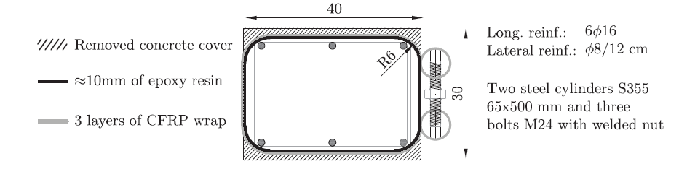
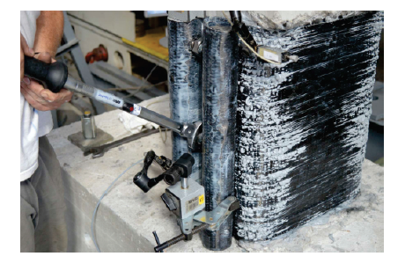
Presstresed FRP jacket

Slide 61
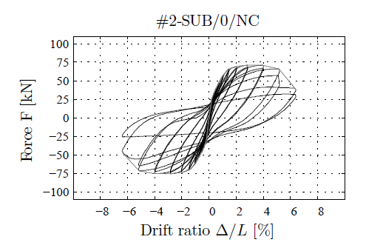
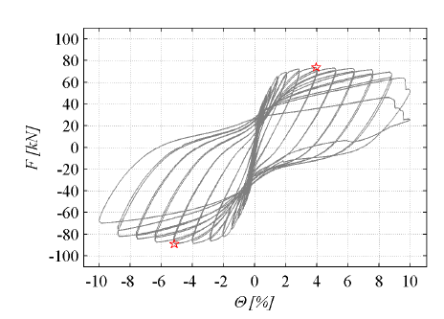
Presstresed FRP jacket

Slide 62
Conclusions
Explicit reduction of seismic forces
Reduction of the initial stiffness
Capacity design
Conservative estimation of the shear capacity
Structural details providing adequate confinement of critical zones and preventing buckling of longitudinal bars
Existing bridges – do not explicitly cover
EC8-3 and EC8-2 can be applied

